Slide 1
Credit Card Fraud Detection using Data Mining models
AI for Cybersecurity Course Project
Università di Pisa
–
Master Degree in Cybersecurity 23/24
Francesco Rubino

Slide 2
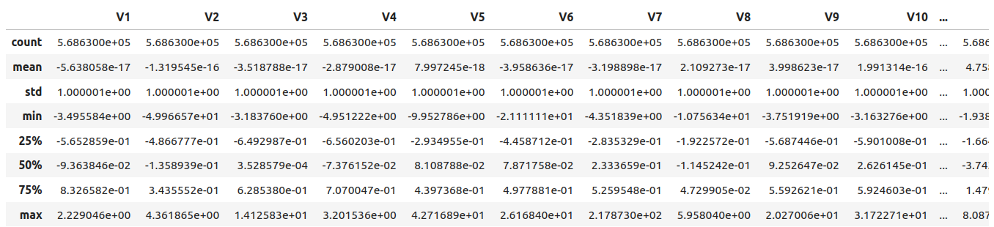
Dataset
The dataset used is the ‘Credit Card Fraud Detection Dataset 2023’ found on the Kaggle website.
31 attributes: 28 anonymous attributes, ID, Amount and Class.
555.000 tuples, consisting of transactions made by European creditcard holders.

Slide 3
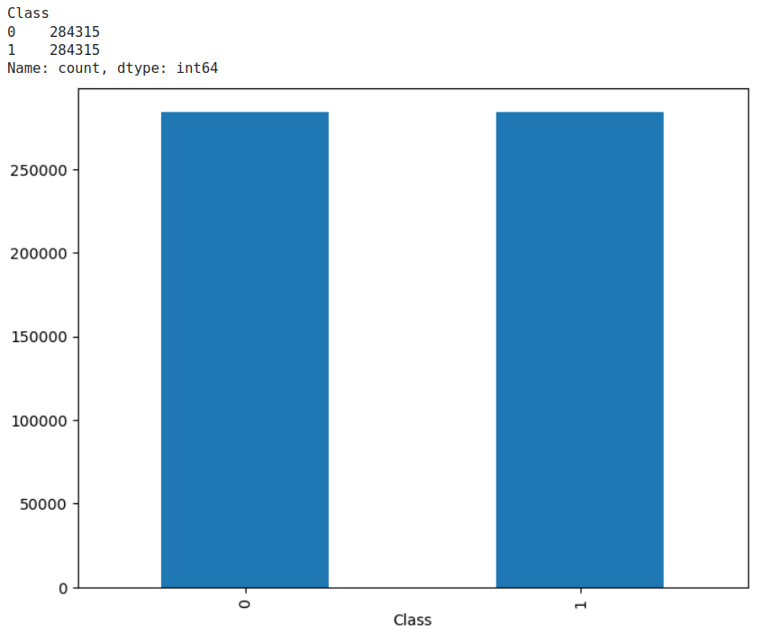
Data Exploration
At a first look the dataset seems already Standard Scaled;
No null values and all numerical continue valued attributes;
Dataset perfectly balanced.

Slide 4
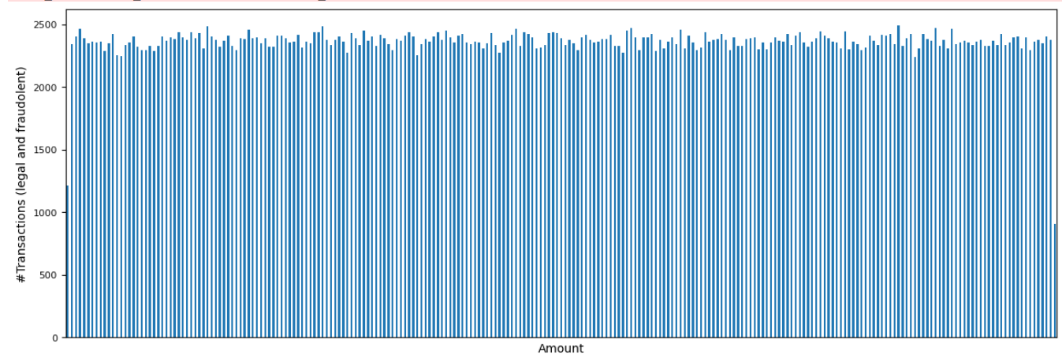
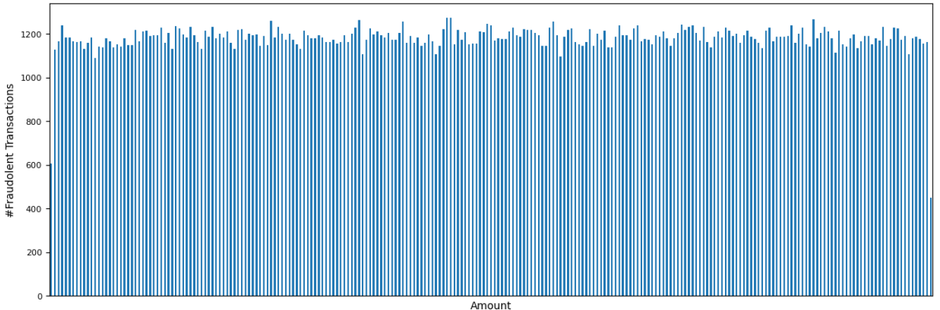
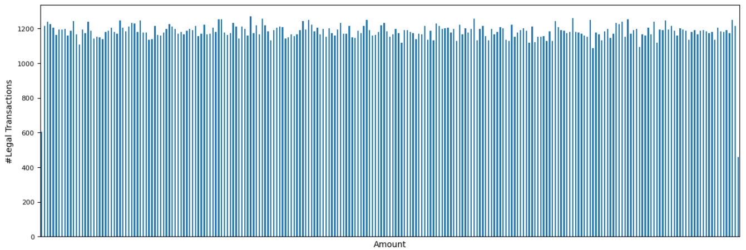
Data Exploration
The amount variable is uniformly distributed whitin its range from 50 € and 24040 €;
The number of transaction per amount is uniformly distributed between the class 0 (legal transactions) and class 1 (fraudolent transactions).

Slide 5
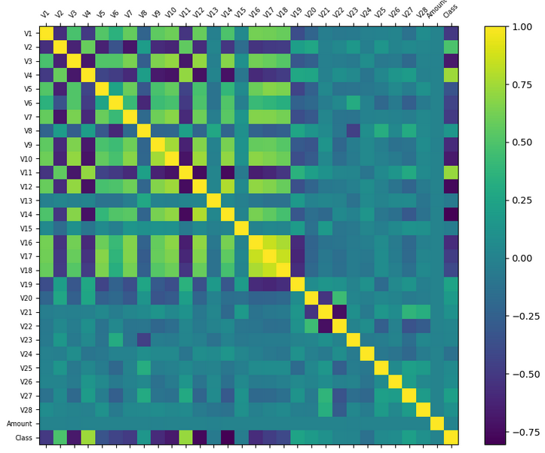
Data Exploration
The correlation matrix confirms that there is a low correlation between the Amount and the class;
There are a lot of anonymous variables with a high correlation with the class;
Useful to reason about feature selection.

Slide 6
Pre-processing phase
Data Cleaning
Data Normalization
Feature Selection
Dataset split

Slide 7


Data Cleaning
Remove the ID attribute;
Removing of NaN values: no NaN values;
Drop duplicates: just one duplicate.
Before
Then

Slide 8
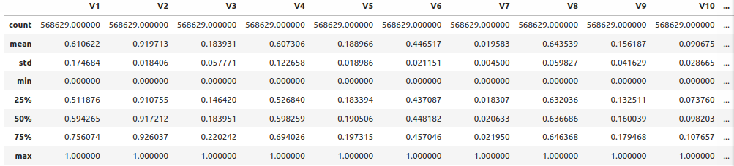
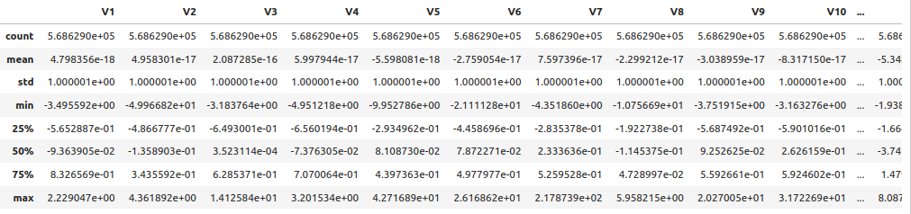
Data Transformation: Scaling
MinMax Scaling
Z-score Scaling
Values of the attributes scaled on an interval between 0 and 1.
Values of the attributes scaled with a mean value of 0 and a variance of 1.

Slide 9


Data Reduction: Feature Selection
Created datasets with less attributes using a feature selection algorithm;
Tried various k parameter: the k used for the tested classifiers is 20;
The parameter used as criterion for the selection is the mutual information;
As suspected, the Amount is not been selected.

Slide 10
Classification Choices
Tested each combination possible between the datasets obtained and the selected classifiers;
Accuracy and fit-time the main metrics considered;
Used 5 fold Cross-Validation for the test and assessment of the performance;
Used T-Test to compare classifiers.
Datasets
Classification Algorithms
MinMax Scaled
Z-Score Scaled
Reduced MinMax Scaled
Reduced Z-Score Scaled
Logistic Regression
Neural Network
Random Forest

Slide 11

Logistic Regression
Convergence to a continued value solution;
Max-iteration set to 1000;
Good performance in low fit-time expected.

Slide 12
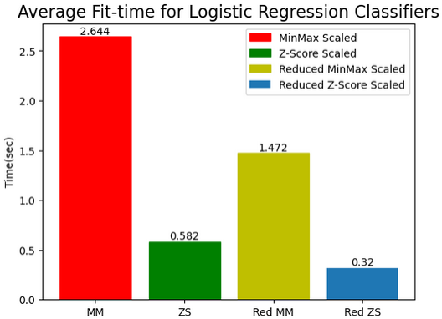
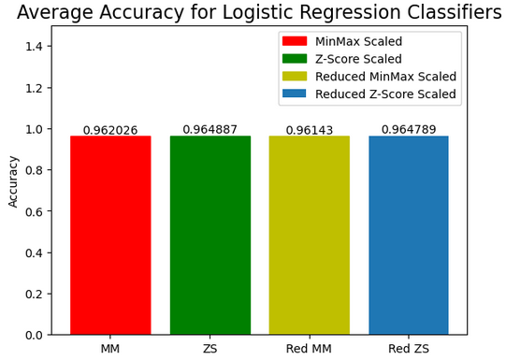
Logistic Regression
MinMax Scaled Dataset
Z-Score Scaled Dataset
Reduced MinMax Scaled Dataset
Reduced Z-Score Scaled Dataset
Average Fit-time
Average Fit-time
Average Fit-time
Average Fit-time
2.644 s
0.582 s
1.472 s
0.312 s
Average Accuracy
Average Accuracy
Average Accuracy
Average Accuracy
0.962026
0.964887
0.96143
0.964789

Slide 13

Neural Network
Sequence of layer to predict the class;
Different configuration tried to find a tradeoff between performance and fit-time;
Used the alan classifier with 1 layer and 10 neurons;
Susceptible to not scaled data, so the previous operations made are essential.

Slide 14
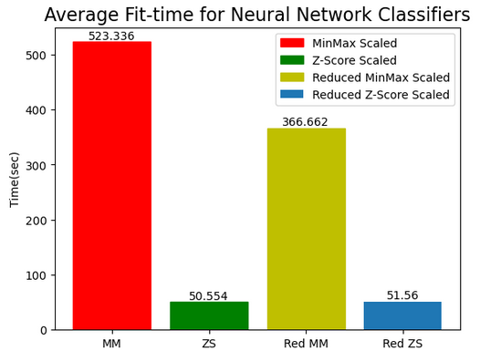
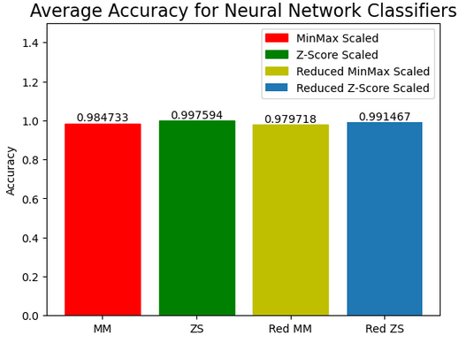
Neural Network
MinMax Scaled Dataset
Z-Score Scaled Dataset
Reduced MinMax Scaled Dataset
Reduced Z-Score Scaled Dataset
Average Fit-time
Average Fit-time
Average Fit-time
Average Fit-time
523.366 s
50.554 s
366.662 s
51.56 s
Average Accuracy
Average Accuracy
Average Accuracy
Average Accuracy
0.984733
0.997594
0.979717
0.991467

Slide 15

Random Forest
Group of decision tree for the prediction: taken the majority class;
Max-depth parameter set to 20, so fully grown trees;
One of the best classifier, high performance expected.

Slide 16
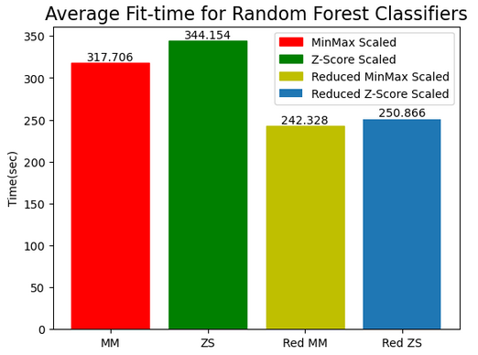
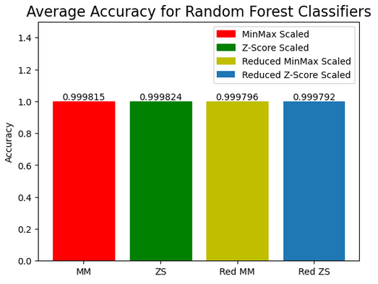
Random Forest
MinMax Scaled Dataset
Z-Score Scaled Dataset
Reduced MinMax Scaled Dataset
Reduced Z-Score Scaled Dataset
Average Fit-time
Average Fit-time
Average Fit-time
Average Fit-time
317.706 s
344.154 s
242.328 s
250.86 s
Average Accuracy
Average Accuracy
Average Accuracy
Average Accuracy
0.999815
0.999824
0.999796
0.999792

Slide 17
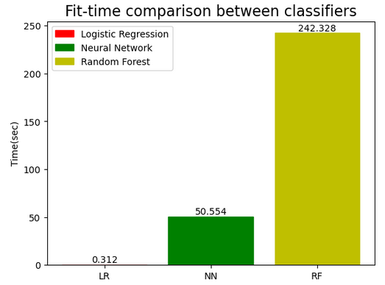
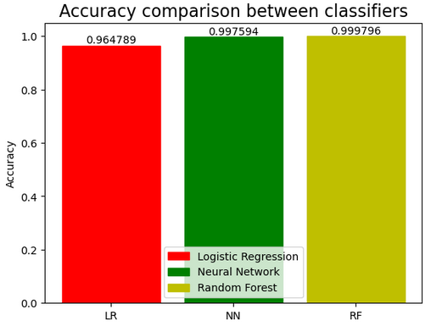
Performance Evaluation
T-Test between Neural Network and Random Forest
The datasets taken in consideration for this last comparison are the Reduced Z-score Scaled one
for the Logistic Regression, the Z-score scaled for the Neural Network and the MinMax Scaled for
the Random Forest.

Slide 18
Improvements
Increase the number of transactions.
1
Feature Selection based on PCA.
2
Try other combination of Neural Network parameters.
3

Slide 19
Python Libraries
Pandas -> dataset handling
Numpy -> array handling
Time -> fit-time
Pyplot -> plot
Scikit-learn -> cross-validation, performance metrics, models
Statistics -> statistical measures
Scipy -> t-test

Slide 20
Link to the Credit Card Fraud Detection Dataset 2023
https://www.kaggle.com/datasets/nelgiriyewithana/credit-card-fraud-detection-dataset-2023

